Slide 1
CEM AX HCM
CEM Business Solutions

Slide 2

About us
Established in 2003
97.7% Customer Satisfaction
12 offices in 8 International locations
ISO 9001-2008 Certification
CAGR: 89%
265 Customers in 19 Industries
Good CSR & Value System
Development Centre in India
Services to 1.Channel
2.End users

Slide 3




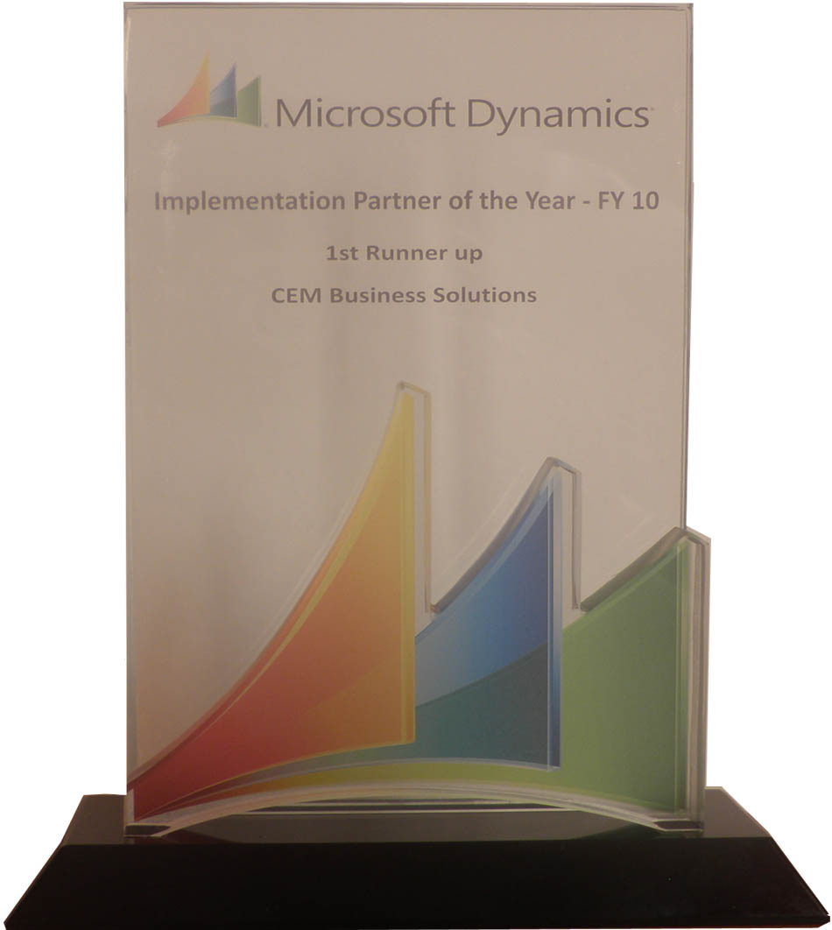





CEM – Microsoft Dynamics Awards
2013 (So Far)
2012
2011
2010
2009
Microsoft Dynamics Awards
Invited Member of
Microsoft Partner Council (MPC)
Partner Advisory Board (PAB)
Enterprise Product Group (EPG)
Member of Microsoft Dynamics AX Council Program
CEM AX Payroll earns CfMD Certification
2012 Microsoft President’s Club Member
Fastest growing Company
Microsoft Best Marketing Partner
Microsoft Best Implementation Partner
2011 Microsoft President’s Club Member
2010 Microsoft Country Partner
Microsoft Best Implementation Partner
2009 Microsoft President’s Club Member
Microsoft Best Implementation Partner
Microsoft Best Sales Partner
Notes:
Timing: 8 minutes
Key Points:
HR professionals strive to transition from administrative/tactical HR to Strategic HR.
They want a single source of truth for data
They take sensitive employee data very seriously
They want to empower their employees and managers and focus on ensuring their organization is attracting and retaining the top talent.
Finally, they want to ensure that employees and managers in their organization are constantly developing, growing, and adapting as their organization changes.
Script:
Today’s HR offers unprecedented opportunities alongside some daunting challenges.
Now, more than ever, HR departments are being asked to play a more strategic role in the direction of organizations. However, they are not setup for success because they currently manage their workforce with multiple disparate systems and are reliant on the IT department to connect those systems.
We have taken a lot of research and feedback from customers and partners and used that to frame what we at Microsoft see as six areas that are top of mind for HR professionals.
Let me dive into each of these one by one.
Single Source of Truth for Data
No way to easily analyze employee and organizational health today
Single Unified HCM
Too many disparate systems today
Securing Sensitive Employee Data
With data and systems in multiple places security of sensitive data is at risk
As organizations grow and become global this is especially a concern
Attracting and Retaining Top Talent
Keeping a strong applicant pool
Ensuring the right people are being hired for the right jobs
Empowering Employees
Too much paperwork and administrative tasks to manage today
Employee and manager self-service to lighten the administrative load freeing up HR professionals for more strategic tasks
Driving Employee & Organizational Development
Ensuring employees are in the right positions to keep them happy and productive
Ensuring strong managers are in place to drive employee development
Ensuring training and other programs are in place to drive employee and organizational development

Slide 4









Offices
USA
UK
India
UAE
Singapore
Qatar
Kuwait
Oman
12 Offices in 8 International locations

Slide 5









Industries Served
Construction
Project Services
Facility Management
Food & Beverage
Agriculture
Aviation
Automotive
Marine
Oil & Gas
Insurance
Banking
Manufacturing
Real Estate
Health & Fitness
Transportation
Trade & Logistics
Retail
Equipment Rental
Telecom
Notes:
Microsoft Dynamics AX 2012 R2 - HCM
Drive HR Impact (Core HRMS)
Personnel Actions and Workflow
Users will be given the option to configure AX to require a more formal way to create new positions and edit positions, with the additional option of AX Workflow as part of the formal action, plus a way to view a history of actions in HR.
For creating one position or multiple positions
For editing position fields, except the position worker assignment field. You can multi-select positions to edit and then edit multiple fields on the position.
Position Budgeting
Tracking of Budget/Cost information in HR - for Position Salary Budget and Position Expended/Position benefit budgets (via Position budget grid)
Ability to create a staging environment for planning next years budget prior to integration with Budget planning.
Integration to budgeting solution (via Budget plan generation- Generate from position forecasting)
Expand on Dimension functionality for integration to budget control (by allowing the budget for a position to be split by more than one position)
Budget generation from position forecasting will generate budget plan lines that will support the ability to:
View and modify the results of multiple forecasts in budget plan scenarios in Budget planning
View and modify budgeted information by budget period
Approved plan amounts are used to create budget register entries in Dynamics AX budget control which then provides the user with the ability to:
View budget to actuals for salaries and benefits using Budget control statistics
View budget to actuals by position when position is used as a financial dimension
Maintain Positions
Copy an existing position as a way to Mass create positions
Mass edit position attributes which includes the ability to Mass expire positions
Mass terminate workers
Add a means to "freeze" or block worker assignments to a position (adding a Available for assignment datetime field)
Benefits Eligibility
Provides an eligibility engine for Benefits. Employees will be eligible for a set of benefits based on the rules of this engine.
Accessing and exercising benefit eligibility rules to determine worker eligibility
Screenings
Screening types like drug or medical, can be setup and associated to Jobs. Results recorded for the worker and can setup as reoccurring so it auto sets up the next screening.
Enhanced Role Centers
Role Center for HR Manager where you could get Injury & Illness Incidents for the month, year, and last year
Or Staffing Manager, where you could see Average days to Recruit for each Department or Applicants by Source
And Training and Development Manager, where you could see information about Open Courses or how many people have taken a particular course
U.S. Payroll
Including HR and Payroll integration
Ceridian Tax Filing Service
Manage Talent (Talent Management)
Tests and Qualifications
Setup of Qualification Test Types, which would be added as defaults on Job and Position, and carried into Recruitment process; i.e., required Tests & minimum scores
Compensation
Enable mass adjustments of compensation structures

Slide 6



CEM Team
Over millions hours of Dynamics experience
Committed to ‘Timely & Quality’ delivery
Qualified people from premium institutes
Onsite / Offshore experience
Incentivized for FTR (First time Right)
Sub contractor experience with large MNCs
Notes:
Microsoft offers a holistic vision for HR professionals, based on an integrated, cost-effective solution.
The solution is designed to help HR professionals manage talent, by securely managing sensitive employee information without IT involvement when attracting, onboarding, retaining, and developing talent across all legal entities
Our solution also helps drive HR impact, by automating administrative HR and freeing up time to focus on strategic, impactful HR… by providing engaging, and familiar employee self-service experiences
Additionally, Microsoft business solutions help HR professionals inspire collaboration, by connecting and unlocking social, organizational and operational intelligence...that inspires innovation, interactions and collaboration for better and faster results
Manage Talent
Recruit top talent by posting job openings both internally and externally, and share applicants across the enterprise providing a powerful tool for any recruiter.
Utilize templates and bookmarks and interoperate with Microsoft Office to increase the efficiency of correspondence with applicants.
Define competencies, tests and qualifications for positions and map them to internal and external candidates and employees to ensure the right people are in the right positions.
Create fixed and variable compensation plans, which includes grade, band and step compensation structures, which can also be mass adjusted.
Enable pay for performance based on employee and organizational performance goals.
Offer the ability to initiate learning, define training course information, manage attendee signup lists, waiting list, withdrawals, and also evaluate courses.
Drive HR Impact
Share workers (employees and contractors), applicants, organizations (e.g. – departments, teams), jobs, positions, and competencies throughout the enterprise eliminating duplicate data - saving time and money.
Maintain position and organization structures (hierarchical, matrix, and team-based) over time and get an accurate picture of historical, current, and future changes.
Formalize position maintenance with personnel actions and an option of approvals, and also optionally track budget/cost information.
Retain employment history, track injuries and illnesses, drug and medical tests, record education, skills, certificates, courses, work experiences, and track loaned equipment.
Define benefit plans and assign benefits based on eligibility rules to individual employees or through mass assignment.
Empower users with employee and manager self-service capabilities such as the ability to maintain competencies and personal information, apply for jobs, register for courses, maintain performance goals, enter and approve absences, enter and approve expenses, and more.
Utilize U.S. Payroll that works seamlessly with HR, Financials, and other components of your Microsoft Dynamics AX solution.
Inspire Collaboration
Control access to sensitive employee data, preserve and retain employee lifetime history, and take advantage of a single source of truth for your employee data enabling exceptional decision making with contextual analytics.
Take advantage of role tailored information at your fingertips with role centers for HR managers, staffing managers, and training and development managers.
Optimize manager and employee communications allowing them to initiate performance discussions through interoperability with Microsoft Outlook.
Utilize the SharePoint based Enterprise Portal to drive communications and information sharing across your organization.
Continue to leverage Microsoft solutions that you already use today for collaboration such as SharePoint, Lync, and Yammer.

Slide 7

CEM AX HCM

Slide 8

Business Challenges – HCM
Lean workforces
Crucial
employment deals
Low levels of employee engagement
Damaged corporate reputations
Productivity pressures
Business Issues in
Human Capital Management
Cost constraints
Frequent change
New areas for business growth
Dispersed and diverse work forces
Notes:
Microsoft Dynamics AX 2012 R2 - HCM
Drive HR Impact (Core HRMS)
Personnel Actions and Workflow
Users will be given the option to configure AX to require a more formal way to create new positions and edit positions, with the additional option of AX Workflow as part of the formal action, plus a way to view a history of actions in HR.
For creating one position or multiple positions
For editing position fields, except the position worker assignment field. You can multi-select positions to edit and then edit multiple fields on the position.
Position Budgeting
Tracking of Budget/Cost information in HR - for Position Salary Budget and Position Expended/Position benefit budgets (via Position budget grid)
Ability to create a staging environment for planning next years budget prior to integration with Budget planning.
Integration to budgeting solution (via Budget plan generation- Generate from position forecasting)
Expand on Dimension functionality for integration to budget control (by allowing the budget for a position to be split by more than one position)
Budget generation from position forecasting will generate budget plan lines that will support the ability to:
View and modify the results of multiple forecasts in budget plan scenarios in Budget planning
View and modify budgeted information by budget period
Approved plan amounts are used to create budget register entries in Dynamics AX budget control which then provides the user with the ability to:
View budget to actuals for salaries and benefits using Budget control statistics
View budget to actuals by position when position is used as a financial dimension
Maintain Positions
Copy an existing position as a way to Mass create positions
Mass edit position attributes which includes the ability to Mass expire positions
Mass terminate workers
Add a means to "freeze" or block worker assignments to a position (adding a Available for assignment datetime field)
Benefits Eligibility
Provides an eligibility engine for Benefits. Employees will be eligible for a set of benefits based on the rules of this engine.
Accessing and exercising benefit eligibility rules to determine worker eligibility
Screenings
Screening types like drug or medical, can be setup and associated to Jobs. Results recorded for the worker and can setup as reoccurring so it auto sets up the next screening.
Enhanced Role Centers
Role Center for HR Manager where you could get Injury & Illness Incidents for the month, year, and last year
Or Staffing Manager, where you could see Average days to Recruit for each Department or Applicants by Source
And Training and Development Manager, where you could see information about Open Courses or how many people have taken a particular course
U.S. Payroll
Including HR and Payroll integration
Ceridian Tax Filing Service
Manage Talent (Talent Management)
Tests and Qualifications
Setup of Qualification Test Types, which would be added as defaults on Job and Position, and carried into Recruitment process; i.e., required Tests & minimum scores
Compensation
Enable mass adjustments of compensation structures

Slide 9
Conceptual Framework – HCM
Person
Applicant
Worker
Position
Jobs
Employment
Legal entity

Slide 10
End-to-End Value Chain – HCM (In clockwise direction)
Plan Workforce
Attract & Recruit
Place & Engage
Manage Exit
Train & Develop
Reward & Retain
Manage Career & Succession
planning
Manage Performance

Slide 11
Need – HCM
HR and Payroll in one Integrated System
Save time
Insight
into personnel costs
Seamless
Integration with Finance and Costing
Improve HCM & payroll accuracy
Manage employee information effectively
Reduce
administrative costs
Streamline your HR processes

Slide 12
Modules – CEM AX HCM
Recruitment Management
Performance Management
Talent Management
Organization Development
Training Management
Payroll Management
Role Specific Dashboard Reports
Enterprise
Self-Service Portal

Slide 13
HR Management
Recruitment Management
Organizational Development
Training Management
Role specific dashboard reports

Slide 14
Recruitment Management
Jobs get in front of the right candidate with the right message at the right time
Create a pipeline that will save recruiter’s time and get results
Target the talent you need
Engage easily and effectively
Improve return on your recruiting dollars and demonstrate how your recruiting strategy is driving business results
Improve selection
On-board seamlessly
Social, mobile and competency-based approach & Accelerate new-hire engagement and impact with automated forms in the employee social network

Slide 15
Recruitment Management

Slide 16
Features
Store job interview notes and forms
Schedule interviews for candidates and configure interview stages
Quickly and easily track status of an applicant through the hiring process
Associate a single applicant with multiple job requisitions
Intuitive and easy to use self-service transactions for managers, employees, candidates, and staffing agencies
Convert applicant information to employee upon hiring to eliminate redundant data entry
Build comprehensive resume database and search your internal talent pool for qualified candidates
Store and maintain unlimited number of resumes, credentials, documentation of industry certification, recommendation letters associated with each applicant
Perform skills queries to determine available candidates. Track referral sources
Provision for raising hire requests and ability to define the job requirements

Slide 17
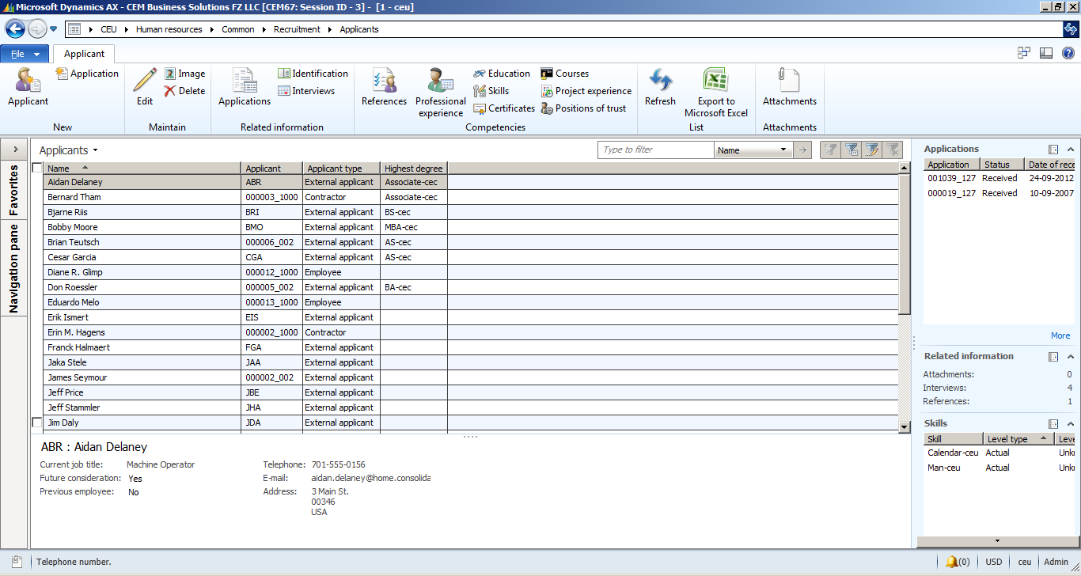
Recruitment Dashboard

Slide 18
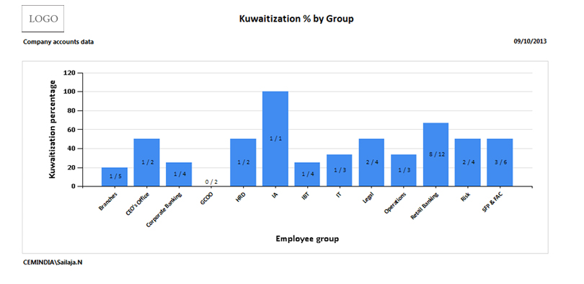
Recruitment Report

Slide 19
Organizational Development
Performance Management
Organization Development
Employee Recognition
Manpower Planning /
Budgeting
Talent Management and Succession Planning
Career planning & Development
Transfer / Promotion

Slide 20
Manpower Planning/Budgeting

Slide 21
Manpower Planning/Budgeting
Expertise built in
Budgeting
Built for business execution
Proven methodology
with a bank of workforce
risks and mitigation
strategies in designing
workforce plans
Developing strategic interventions, and defining, integrating, and interpreting workforce information
Calculation of cost of the manpower required by the business units and preparation of the manpower plan proposal
Enable what-if analysis to compare various scenarios
Proper planning results in improved short- and long-term recruiting, succession, learning, development, performance, and other workforce initiatives

Slide 22
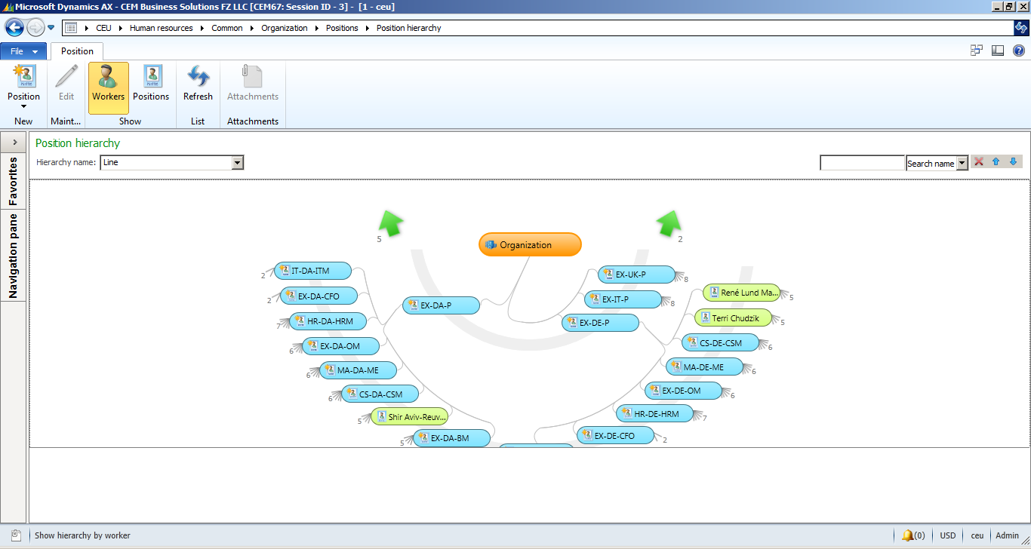
Manpower Planning/Budgeting Dashboard

Slide 23
Career Planning & Development
Career Planning & Development
Assemble and analyse corporate succession planning data
Plan workforce advancement paths
Assess management impact on employee advancement
Promote communication between supervisors and their subordinates
Investigate workforce advancement trends and issues at any organisational level
Link employee career plans to training and development and performance improvement plans
Match appropriate employee competencies and abilities with positions
Develop employee career management strategies
Improve communication between supervisors and subordinates in managing their career goals and strategies
Ability to maintain the minimum period to be spent in each position in order to be eligible to move to the next level in the career path
Assist employees to develop appropriate performance management strategies to further their career goals

Slide 24
Performance Management
Employees and Managers can align individual goals
Can easily track issues and accelerate work on top-priority projects
Communicate continuously
Align Goals
Easy, engaging focal reviews
Compare and rate employees across the same dimensions
Deliver relevant formal reviews
Identify top talent
Intuitive, Visual Employee Comparisons and Writing Assistant and Coaching Advisor
Calibrate performance
Support managers

Slide 25
Performance Management

Slide 26
Talent Management
Create Development Plans
Aligning workforce with key objectives
Automated recruitment process
Implement compensation and reward programs
Create on-roll employee development plans
Proactive succession and development management
Comprehensive learning environment for Training needs
Identify the necessary manpower skills

Slide 27
Features – Talent Management
Talent Management
Compensation Management
Course Management
Employee Performance Tracking

Slide 28
Compensation
Identify and develop the skills necessary to
align your workforce with business goals
Implement innovative reward programs
Build a competency catalogue that can be leveraged by all talent management processes
Flexible, fixed
and variable compensation plans
Define key competencies along your job architecture and cultivate talent pools accordingly
Grade, band, and
step-by-step compensation structures

Slide 29
Course Management
Comprehensive, integrated learning environment - anytime and anywhere
Create and manage course offerings
Help instructors manage attendee participation and activities for their courses
Empower employees to share best practices
Support the creation, distribution, and
storage of course materials
Control learning processes

Slide 30
Succession Planning
Address current and potential talent gaps & proactively identify your go-to employees and develop them for upcoming job transitions
Identify key positions
Provide talent continuity
Gain visibility into employee experience, expertise, performance, and career aspirations & map every staffing move
Gain workforce insights
Understand employee histories
Address talent gaps, engage employees,
and accelerate learning with competency
based planning
Improve career planning
Calibrate ratings

Slide 31
Succession Planning

Slide 32
Features – Succession Planning
Features
Provision to perform Succession Planning for an Employee or a Position
Competency Match count/ratio can be used for Successors Identification
System supports Competency based Succession Planning and Successor Identification
Competency of the employee or position will form the target competency against which the successors can be identified
Upon choosing the Career Planning, system will list the successors based on the Career Plan set for employees

Slide 33
Transfer/Promotion
Route the transactions in the workflow involving HR, based on parameter setting for the number of days the transfer is requested
Provide a functionality to request for transfer – temporary as well as permanent
Requests for permanent transfers to a higher positions is termed as promotions and goes through the screening/shortlisting/interview process carried out by the recruitment department, if the vacancy exists
Alert for performance appraisal, if an employee sends a request for transfer after spending a minimum of 3 months
Provide an analysis (in the form of report) and alert if employees of same position are swapped among locations
If the transfer request type is ‘permanent’, then provide an option to carry out career path validation

Slide 34
Employee Recognition
Request for recognitions and nominations on specific categories
Employee nomination by Managers
Various categories of nomination
Produce Certificates and Leave Credits
Integrate Recognition with leave & Performance Management

Slide 35
Training Management
Keep records up-to-date to reflect current training status
More than 40 standard training reports complying with government regulations
Tracking Capabilities
Comprehensive Reporting
Acknowledge class enrolment and course completion with your choice of standard e-mails and letters
Create unique letter formats and generate course catalogues to encourage enrolment
Enrolling Employees
Employee Communication
Set up classes, schedule attendance, and manage class rosters for students and instructors
Automatically checks class capacities and course prerequisites, and assigns employees to training-based job requirements

Slide 36
Training Management

Slide 37
Features – Training Management
Define and track skills assigned to job descriptions
Manage job descriptions and corresponding training requirements assigned to each employee
Define training requirements for each skill
Automatic notification of expiring certifications
Training Management
Track and manage specific training course requirements (descriptions, level…)
Monitor employee training history with current job/skill requirements
Review and Termination tracking
Employee training tracking software automates scheduling, record-keeping, and correspondence to ensure employees receive the training they need

Slide 38
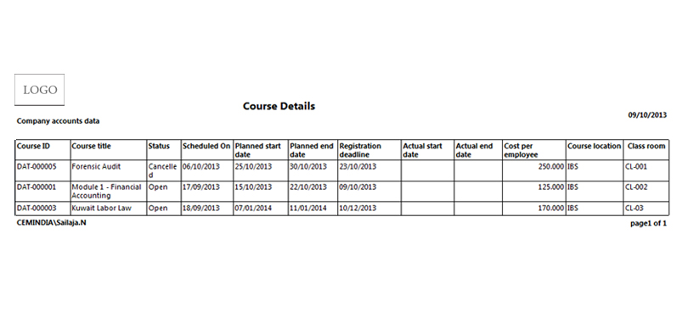
Training Report

Slide 39
Role Specific Dashboard Reports
Leverage clear definitions and formulas to communicate a uniform message and understanding
Share findings and improve and hasten collaboration and decision making
Drill down into organization structure and cost center hierarchy to uncover trends
Extend already made investments by integrating customer-specific HR content from Microsoft Dynamics AX
Achieve quick time to value with predefined software and HR content based on best practices

Slide 40
Features – Role Specific Dashboard Reports
Attract and retain talent
Increase organizational insight
Store and access your employee information in one place
Provide convenient, online access with Employee Portal
Recruit and preserve talent with powerful tools to streamline the recruiting process
Help maximize employee potential through training and development programs
Increases speed productivity
Maintain your organization, job, and position hierarchies and have the flexibility to make changes based on business needs
View line organizational charts for functions and reporting relationships, and manage matrix- and project-based assignments.
Give your human resource team efficient access to the employee and job-related information they need to manage employees and teams across your organization
Easily track a history of employees, positions, and organization units by effective date.
Give employees online access to a host of information, such as training, personal data, and performance
You can also manage recruitment, track applicants, and much more

Slide 41
CfMD – CEM AX Payroll
CfMD Certification
Microsoft Corporation’s highest standard for partner-developed software
Rigorous software testing by Microsoft, VeriTest and Lion Bridge in multiple locations including China
Source Code in Escrow account in Europe
Must have at least 10 customers’ endorsements before certification
The solution provider should be a Gold Certified Partner

Slide 42
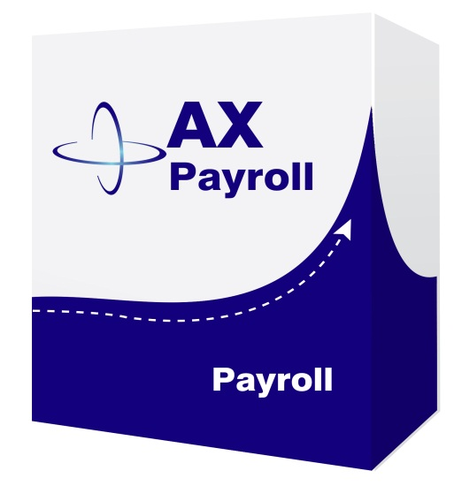
Modules – CEM AX Payroll
Leave
Management
Claims Management
Time Management
Insurance Administration
Loan Management
Social Security Management
Employee Relations Management

Slide 43
Process flow - Payroll

Slide 44
Leave Management
Option to capture the actual leave dates
Allows defining any type of absence codes with basing parameters
Allows defining of custom validations
Captures the accrual policy, to define and use it during the absence request and payroll processing
Allows initiating a leave settlement payroll based on the leave type and its parameter setup
Efficient attendance calculation

Slide 45
Time Management
Can create “n” number of shifts with multiple timings
Captures the shift details, individual employees shift cycle and attendance with overtime details
Can create individual or in bulk employee calendar which capture the shift cycle for a date range
Captures
holidays effectively for overtime calculations
Enhancement to flexi hours,for instance, flexibility to define the Ramadan Period, where in the ending date of Ramadan can be done on a post-dated activity
Allows defining of custom validations

Slide 46
Social Security Management
Captures details of employees for whom both employer and employee contribute an amount
Easy definition of employer contribution, wherein employee contribution can be specified to be directed to the payroll as a deduction part
Social security in GCC countries – PIFSS-Kuwait, GOSI-KSA etc.

Slide 47
Claims Management
Support reimbursement processes for the employees
Allows defining any number of claims
Uses the employee benefit details for the claims validation
Allows making the payment through payroll to the employee or to any third party

Slide 48
Medical/Health/Life Insurance Management
Facilitates advance payment and deduction in instalments
Allows multiple types of leans & advances, and employee’s eligibility through the Employee Benefit Screen
Allows the flexibility of giving exemption from deduction for a specified month, for a specified employee based on the need
Allows requesting the loans and advances with easy instalments
Allows repayment of the advance payment in bulk at the discreet decision of the employee
Seamlessly integrated with the financial module

Slide 49
Loan Management
Loan Types
Loan Application
Loan Approval
Loan Payment
Loan Repayment
Loan Request
Loan Processing
Loan Instalment Details
Loan type will allow user to create various loan types in the organization
Loan Application will be raised by the employee to the management as a request for loan
All requested Loan Applications will be shown in this screen user can approve or reject a particular loan application
Separate loan payment against an approved loan application is recorded in this screen
If an employee repays loan amount to the company that will be recorded and posted in loan repayment screen
List of loan requests are available in loan request module
Loan processing from start to end with EMI start and end date is automated here
Loan installment details can be tracked EMI wise with date

Slide 50
Employee Relations Management
Employees can request for promotion, location transfer and resignation
Workflow is available for promotion, transfer & resignation request approval, employee grievance to the higher authority and to intimate the employee recognition to the HR department
Exit interview can be conducted to the resigned candidates & their feedback can be noted against their resignation
Employee notice period can be tracked while resigning
Employee transfer days/year can be controlled
Recognition leaves will integrate with employee leave entitlement
Employees can select an option whether to serve the notice period or to pay notice period amount to the company
Recognition certification can be provided to the employees
Grievance request can be routed to different departments and action taken against can be noted. Warning letters can be provided to employees against whom grievance was proved
Recognised employees can be awarded with leaves

Slide 51
Employee Separation

Slide 52
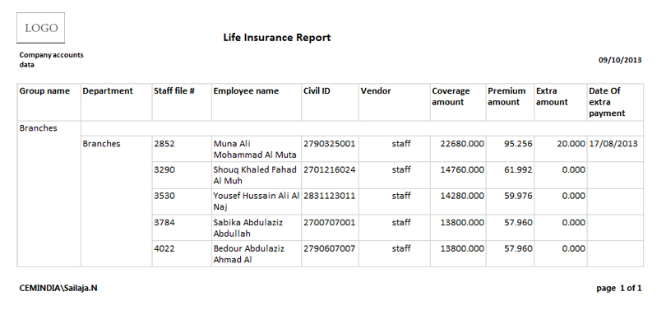
Employee Relation Report

Slide 53
Benefits – CEM AX Payroll
Improve organization with
consolidation of payroll records
and reports
Reliable and seamlessly integrated system
User friendly
Reduce time spent calculating and completing government payroll forms
Eliminate tax penalties for inaccurate returns or late payments
Minimizing Errors and Saving Time
Automate payroll calculation
Improve payroll accuracy with automatic tax and deduction calculations
Improve management reports by tracking labour paid by job, cost center, or account
Advance leave planning

Slide 54
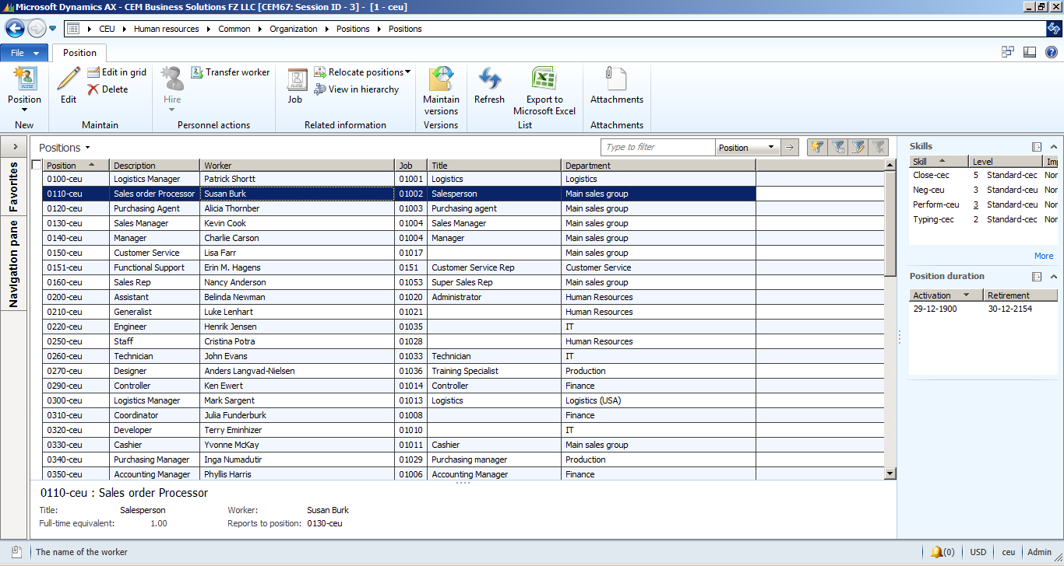
Dashboard – Payroll

Slide 55
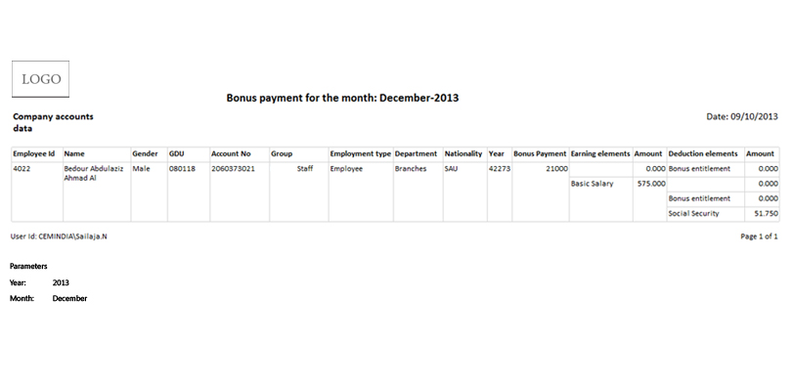
Payroll Report

Slide 56
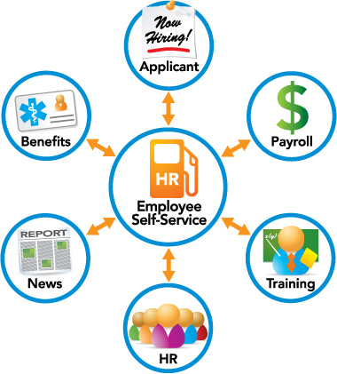
Enterprise Self-Service Portal Management

Slide 57
Enterprise Self-Service Portal
Changes and updates are reflected in real time
HR productivity and efficiency is
improved as staff is able to focus on
more important issues
Phone calls are
reduced
Data entry errors are eliminated
Non-value added functions are eliminated

Slide 58
Enterprise Self-Service Portal
Taxes and Deductions
Vacation, Holiday and Sick Pay
Training and Certification
Dependent and Beneficiary Information
Emergency Contacts
Modification Alerts
Personal Information
View deductions for taxes
View days taken, quantity, total per year, time left to take and start and end date
View, edit, add or remove beneficiary and dependent information
View testing, training and special certifications with expired dates
Add or edit emergency contacts and set up alerts to HR or payroll when a record has been modified
View personal information such as contact, birth date, marital status and hire date plus employee review information
Update functions allow employees to change phone, email, address, city & postal code

Slide 59
Features – Enterprise Self-service Portal
Apply for jobs
Register for classes and manage waiting lists
Maintain performance goals
Initiate employee discussions
Maintain
competencies
Enterprise self-service portal
Maintain personal information
Take online questionnaires
Manage recruiting
Enter and approve absences
Manage travel and expenses, procurement, and approval limits

Slide 60
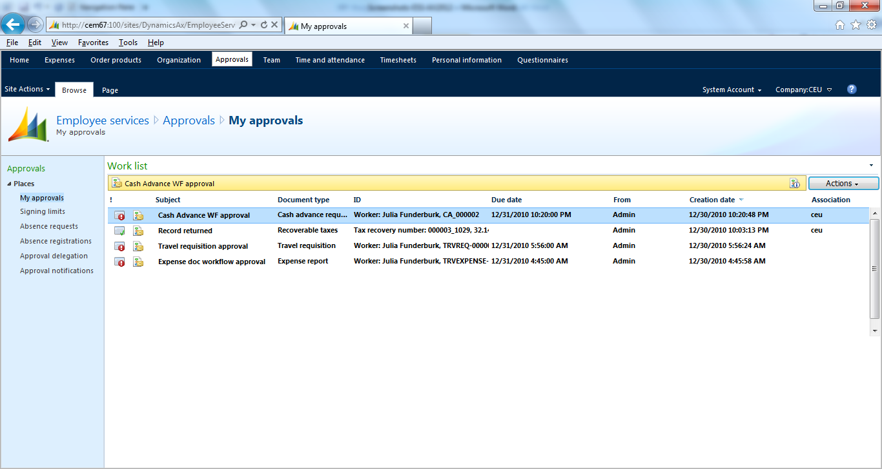
Dashboard – Enterprise Self-service Portal

Slide 61

Why CEM?
Domain expertise in 19 Industry Verticals
97.7% Customer Satisfaction
End-to-end service from implementation to support
Over Million hours of Microsoft Dynamics experience
24x7 Operations
Microsoft Dynamics’ Best implementation partner 3 years in a row
265 happy customers
Proven “Sure Step Methodology”
Successful timely project completion
Lower TCO (Total cost of ownership) by blended model
Notes:
Microsoft Dynamics AX 2012 R2 - HCM
Drive HR Impact (Core HRMS)
Personnel Actions and Workflow
Users will be given the option to configure AX to require a more formal way to create new positions and edit positions, with the additional option of AX Workflow as part of the formal action, plus a way to view a history of actions in HR.
For creating one position or multiple positions
For editing position fields, except the position worker assignment field. You can multi-select positions to edit and then edit multiple fields on the position.
Position Budgeting
Tracking of Budget/Cost information in HR - for Position Salary Budget and Position Expended/Position benefit budgets (via Position budget grid)
Ability to create a staging environment for planning next years budget prior to integration with Budget planning.
Integration to budgeting solution (via Budget plan generation- Generate from position forecasting)
Expand on Dimension functionality for integration to budget control (by allowing the budget for a position to be split by more than one position)
Budget generation from position forecasting will generate budget plan lines that will support the ability to:
View and modify the results of multiple forecasts in budget plan scenarios in Budget planning
View and modify budgeted information by budget period
Approved plan amounts are used to create budget register entries in Dynamics AX budget control which then provides the user with the ability to:
View budget to actuals for salaries and benefits using Budget control statistics
View budget to actuals by position when position is used as a financial dimension
Maintain Positions
Copy an existing position as a way to Mass create positions
Mass edit position attributes which includes the ability to Mass expire positions
Mass terminate workers
Add a means to "freeze" or block worker assignments to a position (adding a Available for assignment datetime field)
Benefits Eligibility
Provides an eligibility engine for Benefits. Employees will be eligible for a set of benefits based on the rules of this engine.
Accessing and exercising benefit eligibility rules to determine worker eligibility
Screenings
Screening types like drug or medical, can be setup and associated to Jobs. Results recorded for the worker and can setup as reoccurring so it auto sets up the next screening.
Enhanced Role Centers
Role Center for HR Manager where you could get Injury & Illness Incidents for the month, year, and last year
Or Staffing Manager, where you could see Average days to Recruit for each Department or Applicants by Source
And Training and Development Manager, where you could see information about Open Courses or how many people have taken a particular course
U.S. Payroll
Including HR and Payroll integration
Ceridian Tax Filing Service
Manage Talent (Talent Management)
Tests and Qualifications
Setup of Qualification Test Types, which would be added as defaults on Job and Position, and carried into Recruitment process; i.e., required Tests & minimum scores
Compensation
Enable mass adjustments of compensation structures

Slide 62

Contact Us
United States
50 Tice Blvd, Suite 340
Woodcliff Lake, NJ 07677
Tel : +1 201 690 5270
4944 Sunrise Blvd. Suite B-4,
Fair Oaks, CA 95628
Tel : +1 916 799 4029
United Kingdom
4 Morel Mews, Dagenham RM8
1 BW Essex
Tel : +44 207 993 6483
Singapore
10 Anson Road,
#26-04 International Plaza,
Singapore 079903
Tel : +65 9757 576
United Arab Emirates
119, Building No. 10, Dubai
Internet City, P.O. Box 502270,
Dubai, U.A.E. Tel : +971 4 3911683
1403, AI Zahra Tower,
King Faisal Street, Sharjah, U.A.E.
Tel : +971 6 5734700
Kuwait
P.O. Box 36350, AI Rass 24754, Kuwait,
Tel : +965 - 22622063
Qatar
P.O. Box #51, Doha Qatar
Tel: +974 300 75 145
India
No:85, Babu Street, Vellala,
Teynampet, Chennai 600 086
Tel : +91 44 33083800

Slide 63
Thank You

